Slide 1


One Stop Centre
Credit Card Application Workflow & Interface Design

Slide 2
Highlights
1
Background
2
Design Exploration
3
Demo
4
Evaluation
5
Impact and Future Application

Slide 3

The Age of Information Overload
The Internet is overloaded with information and services
New products and services are pushed out constantly from industries like Ecommerce and Banking
Notes:
The internet is overloaded with information, and services, and this growth will continue in the foreseeable future. With new products being pushed out online daily from industries like Ecommerce and Banking services, the existing user interface needs to evolve to assist user in making an informed decision in the shortest possible time.

Slide 4

Internet Banking: Credit Card Application
Understanding credit card services
Tedious online application process
Notes:
For this project, we are focusing on credit card application in Banking websites. The specific problems are, understanding the slew of credit card services and tedious online application process.

Slide 5
Problem Statement
Internet users are overloaded with an ever-growing amount of information. This debilitates user in arriving at a decision quickly and using a web service becomes tiring.
Targeting DBS bank card, this project aims to explore a new application flow to increase user satisfaction and learnability using streamlining and gamification techniques.
Notes:
So the overarching problem is information overload, and our UI implementation is focused on helping user make arrived at a decision quickly and reduce the painfulness of the application process
In our case, which is credit card application, there are a long list of credit cards and details to understand, and application process is tedious. These problem will be tackled in our design exploration.

Slide 6
Design Exploration
Notes:
http://www.rapidtables.com/convert/color/rgb-to-hex.htm

Slide 7
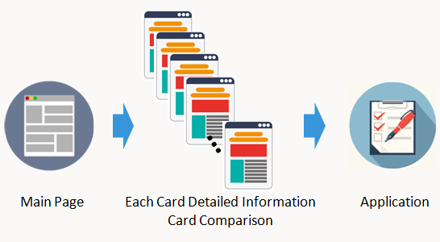
Original Design
Linear flow | Overwhelming information | Long and tedious application

Slide 8
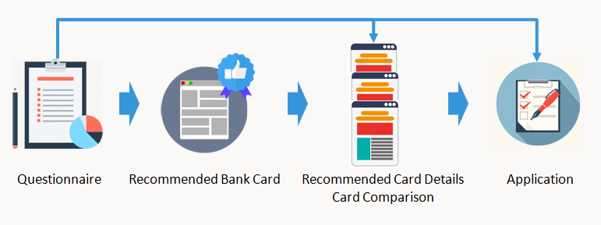
Our Design
Streamline: To improve the efficiency of a process, business or organization by simplifying or eliminating unnecessary steps, using modernizing techniques, or taking other approaches.
Integrated structure | Streamline, gamification, adhere to UI guidelines |Increase satisfaction and learnability

Slide 9
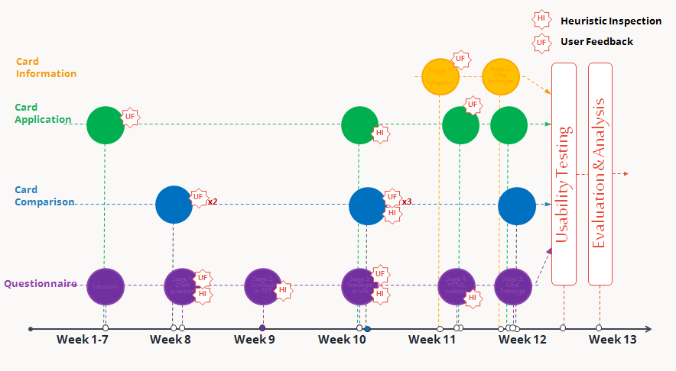
Timeline
Heuristic Inspection
User Feedback

Slide 10
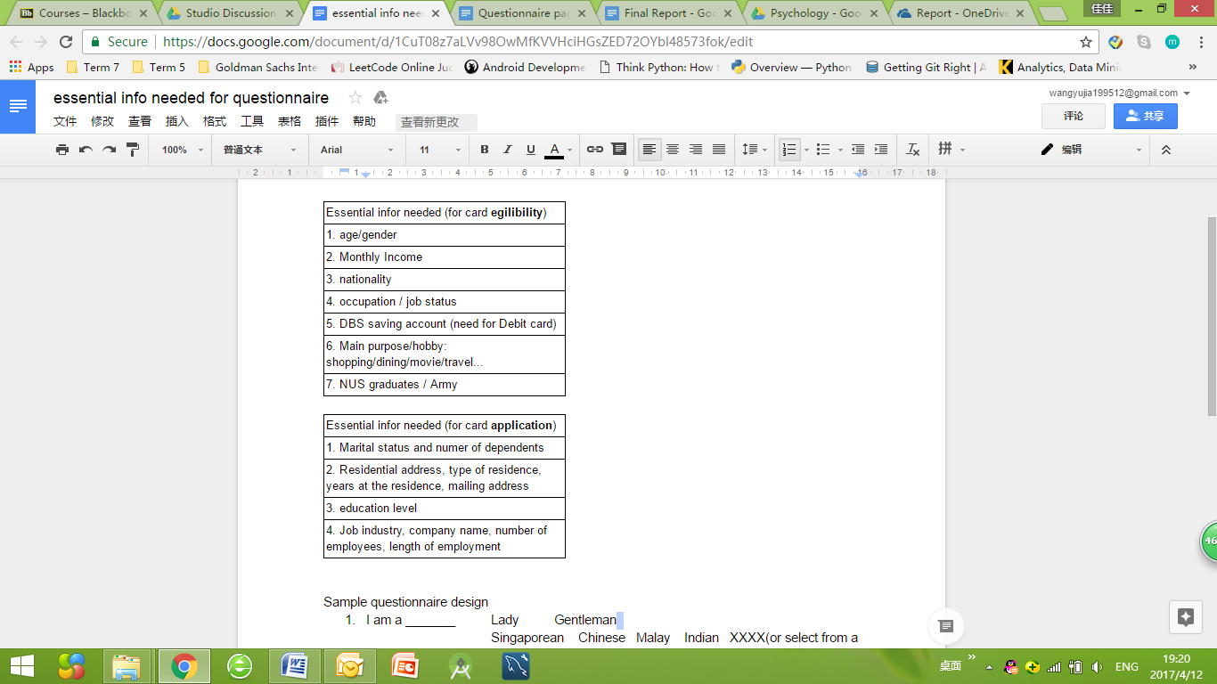
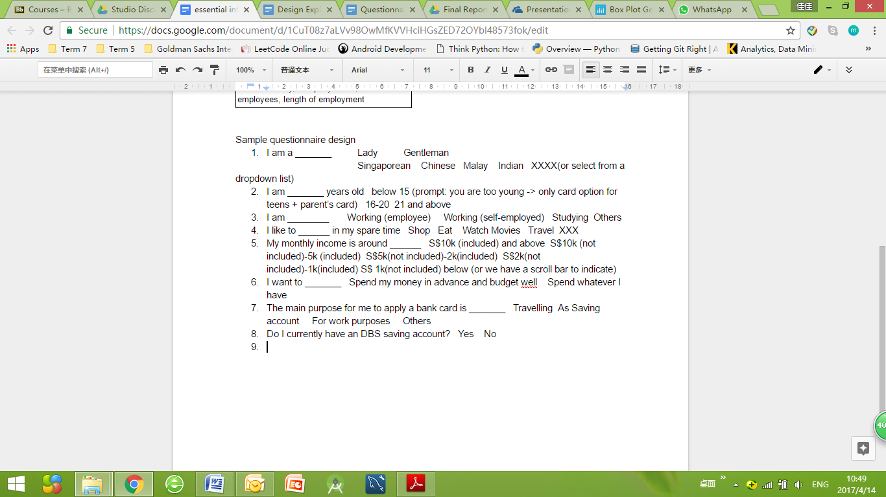
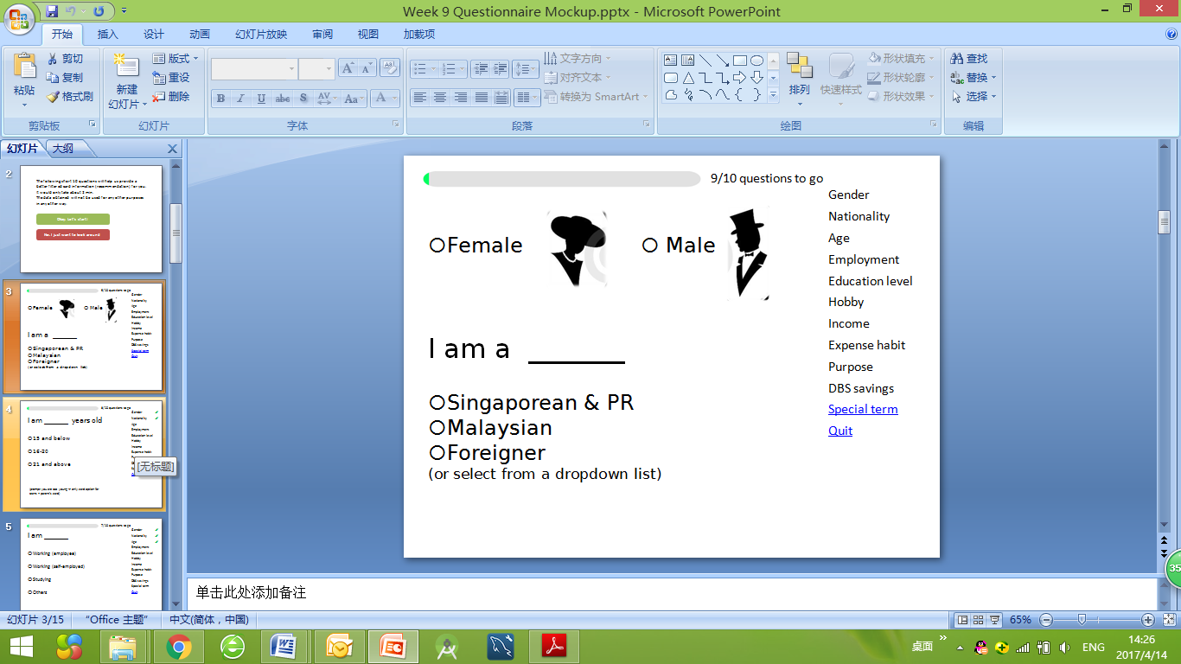
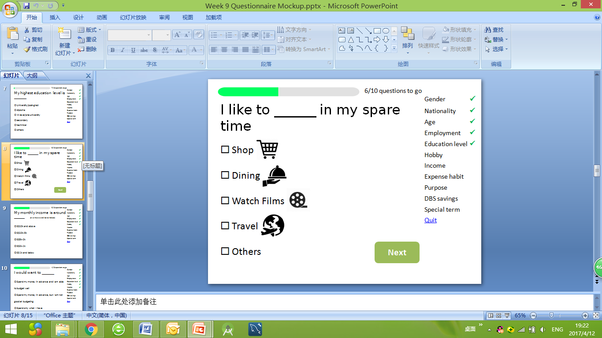
Questionnaire
HI
UF
Stage 1: Questionnaire Draft in Word Document
Stage 2: Mock up of Questionnaire UI

Slide 11
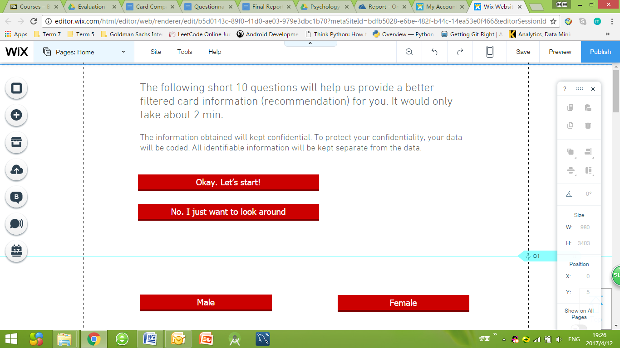
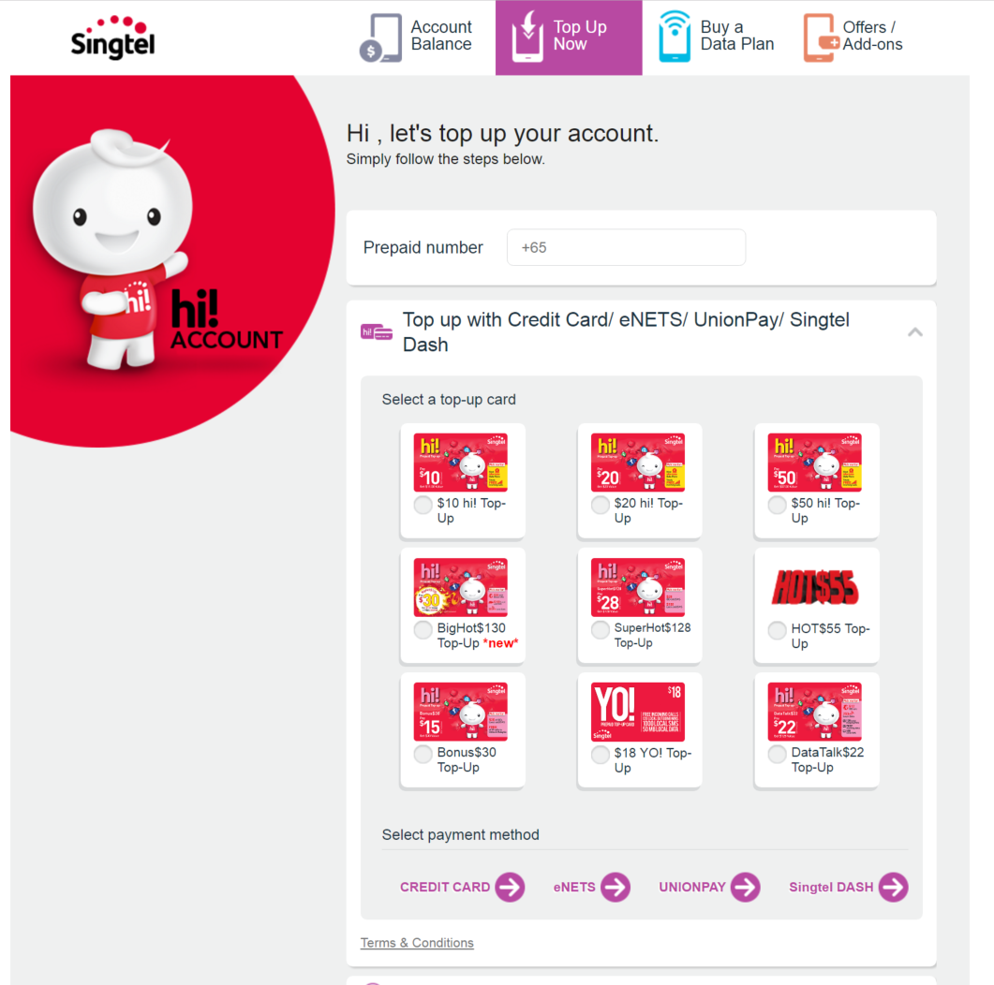
Questionnaire
Literature Review
Alleviates the pain of filling in forms
Dashlane
Singtel’s Prepaid Card top up
HI
UF
Stage 1: Questionnaire Draft in Word Document
Stage 2: Mock up of Questionnaire UI
Stage 3: Questionnaire Prototype on Wix

Slide 12
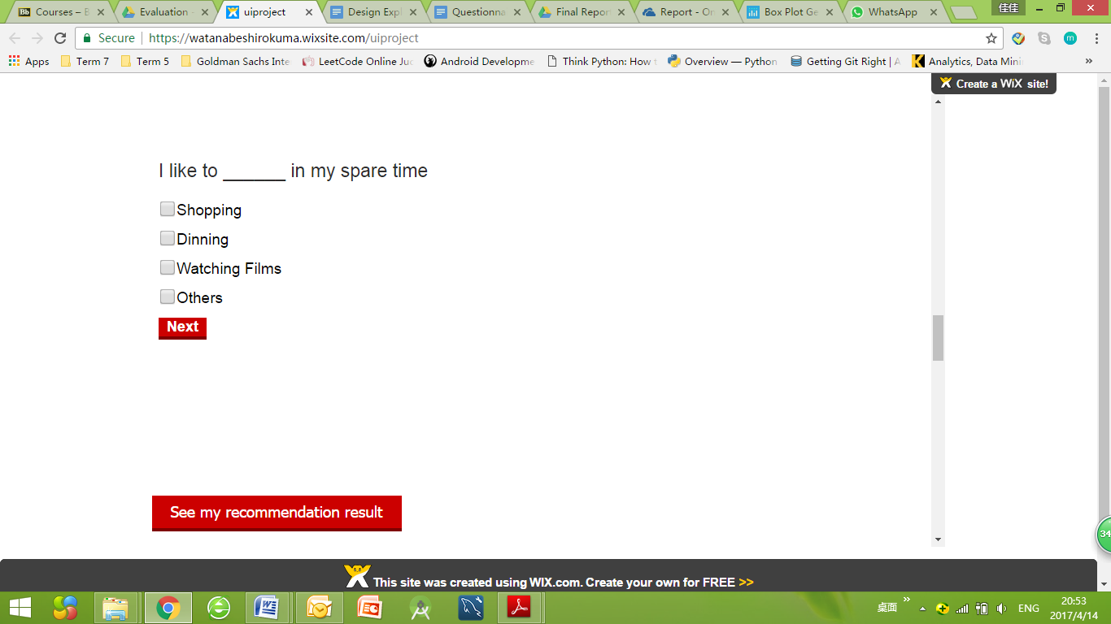
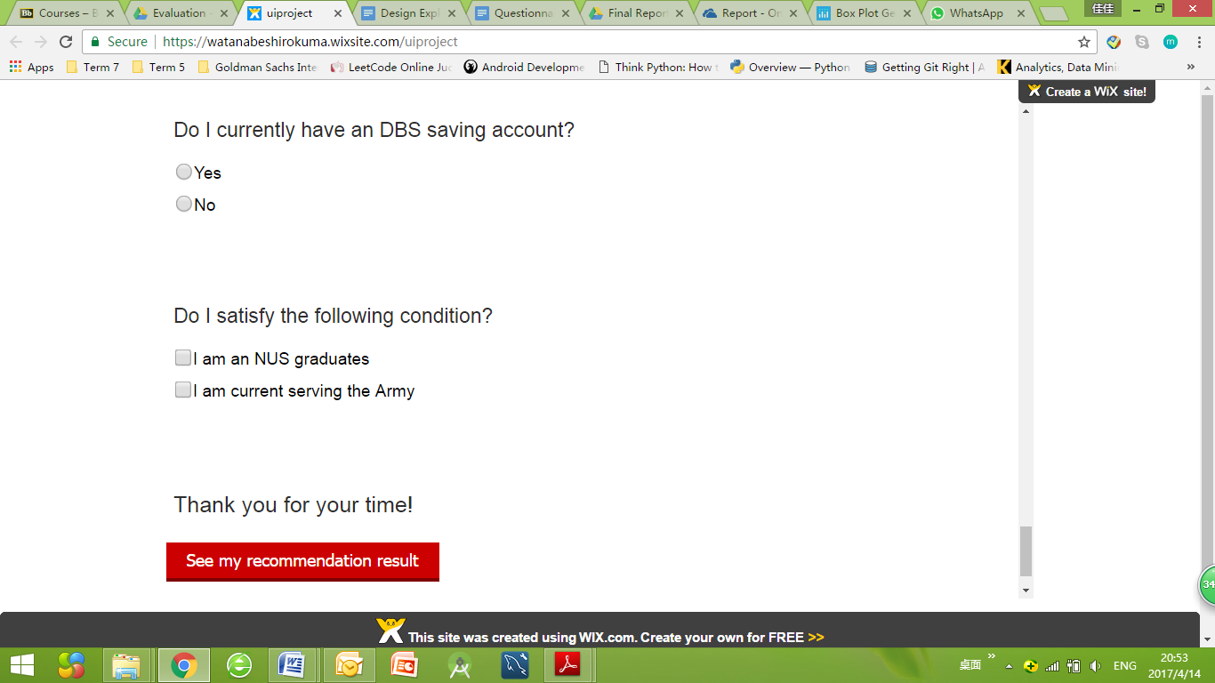
Questionnaire
HI
HI
UF
Stage 1: Questionnaire Draft in Word Document
Stage 2: Mock up of Questionnaire UI
Stage 3: Questionnaire Prototype on Wix
Stage 4: HTML fully functioning UI Prototype
HI
UF

Slide 13
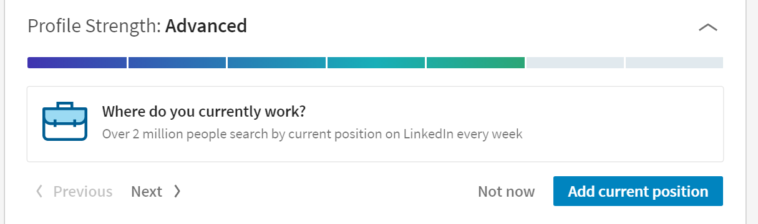
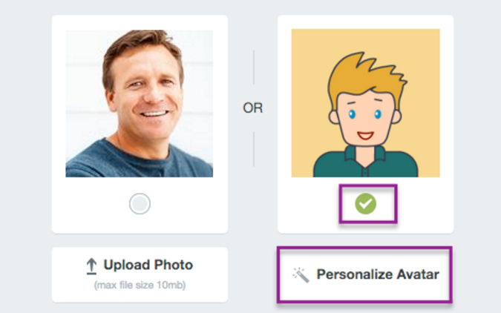
Questionnaire
Literature Review
Gamification Element
LinkedIn
Edmodo
HI
UF
Stage 1: Questionnaire Draft in Word Document
Stage 2: Mock up of Questionnaire UI
Stage 3: Questionnaire Prototype on Wix
Stage 4: HTML fully functioning UI Prototype

Slide 14
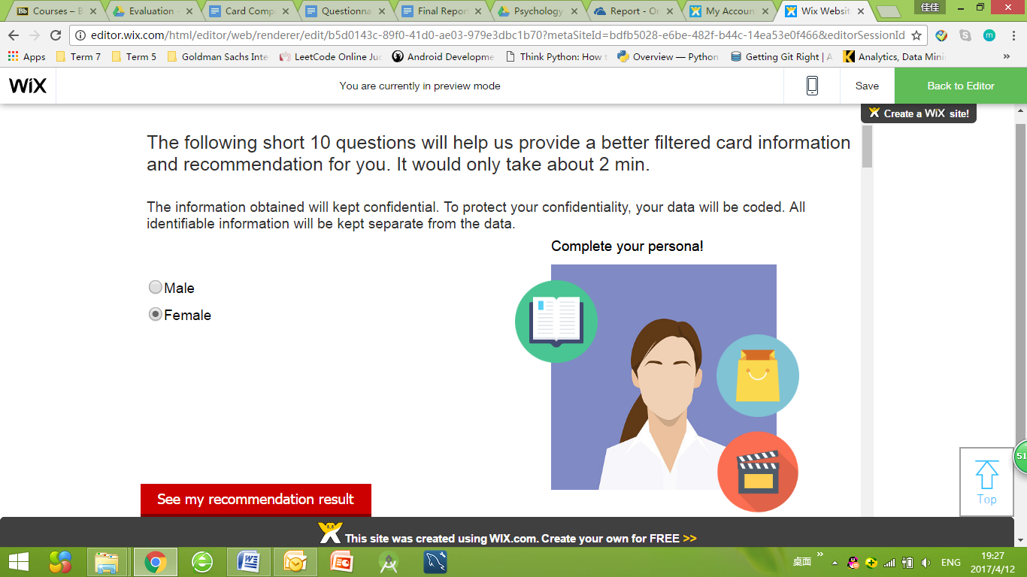
Questionnaire
HI
HI
UF
Stage 1: Questionnaire Draft in Word Document
Stage 2: Mock up of Questionnaire UI
Stage 3: Questionnaire Prototype on Wix
HI
Stage 5: HTML fully functioning UI Prototype v2
Stage 4: HTML fully functioning UI Prototype
HI
UF

Slide 15
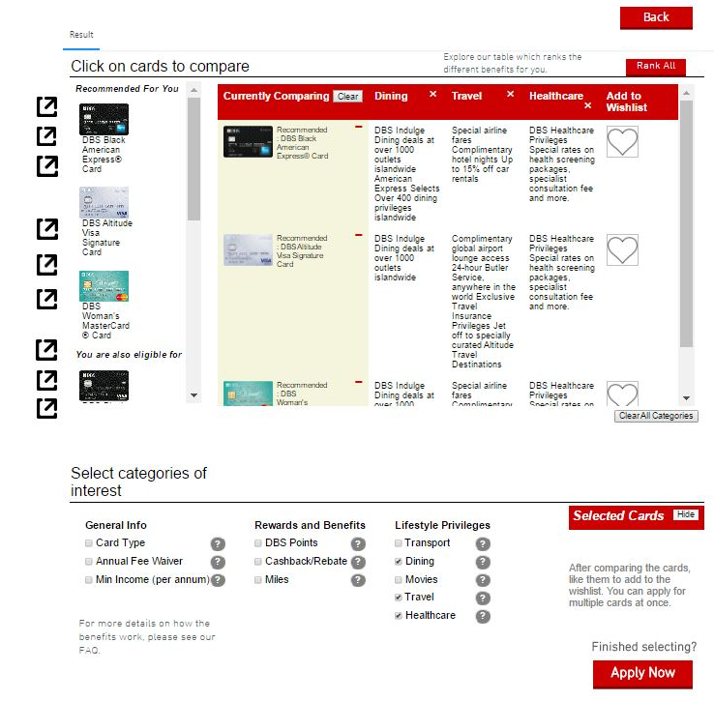
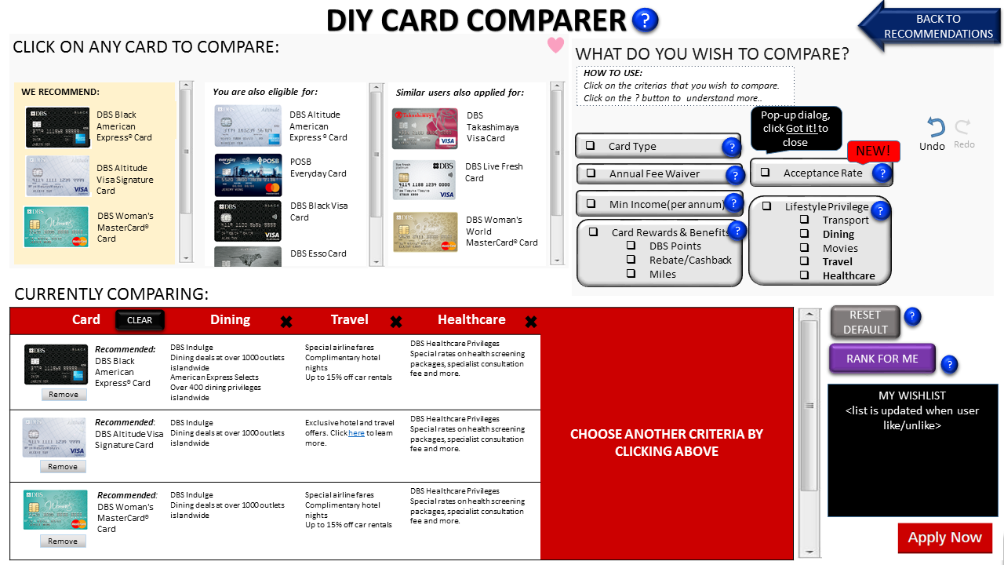
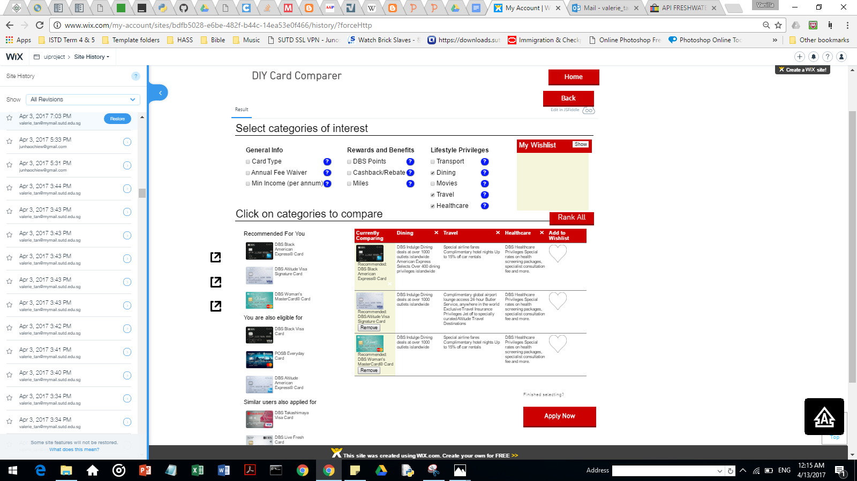
Card Comparison
Stage 1: Validation of Concept (Powerpoint)
UF
UF
UF
UF
UF
HI
Stage 2: Improvement of User Interface (Wix + HTML)
Stage 3: Working Product implemented for User Testing (HTML)

Slide 16
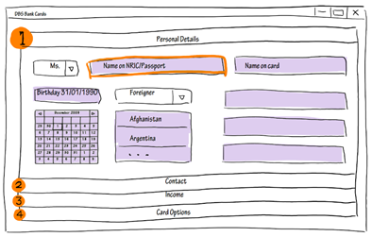
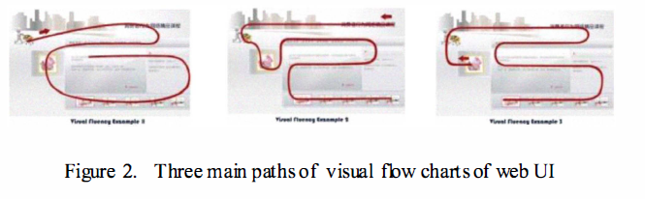
Card Application
Literature Review
Navigation System
Research Paper by Shandong University
Stage 1: Initial application page draft

Slide 17
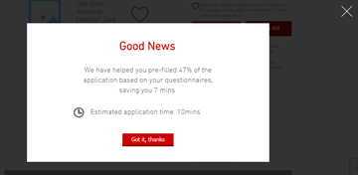
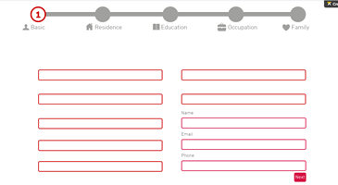
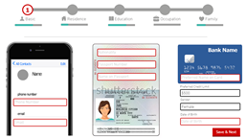
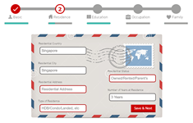
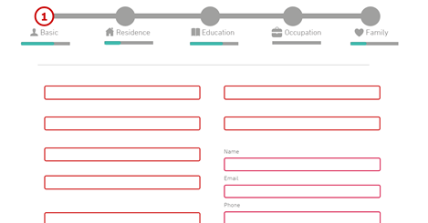
Card Application
UF
Stage 1: Initial application page draft
Stage 2: Mock up of Application UI
HI
UF
Stage 4: Functional application prototype v2
Stage 3: Application prototype

Slide 18
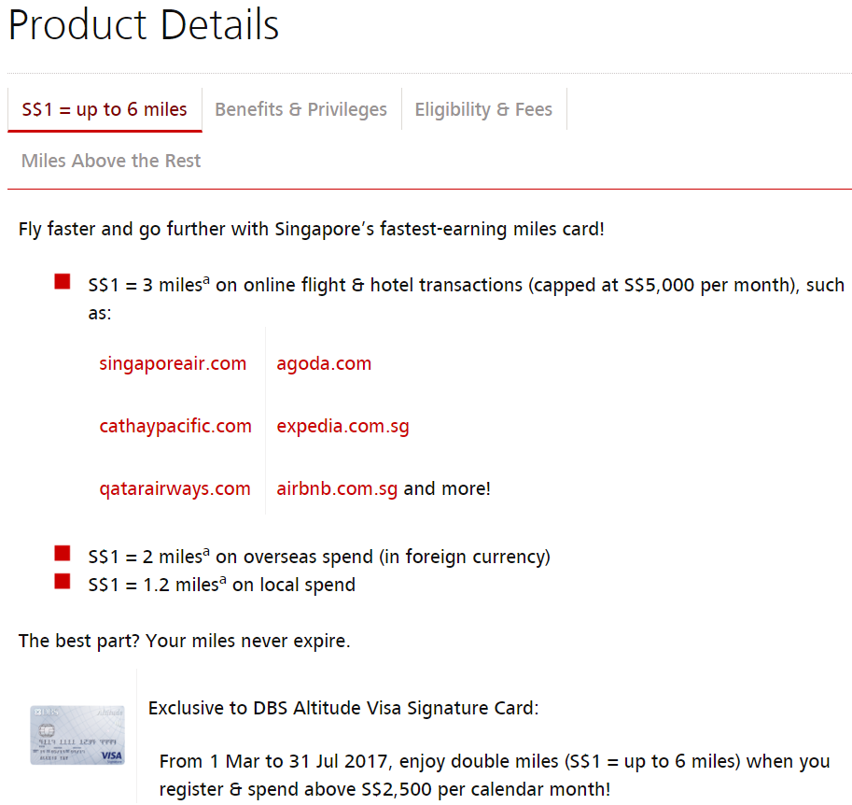
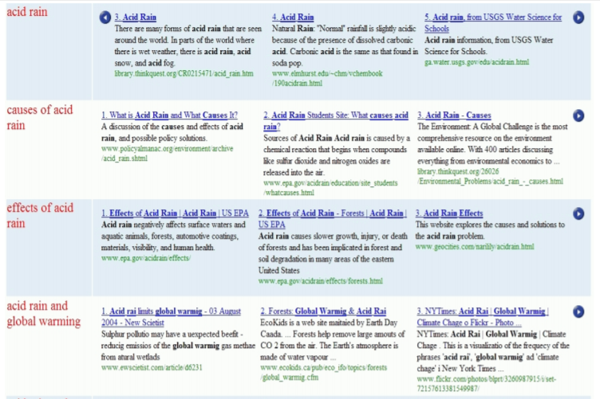
Card Information
Literature Review
Query Aspect
Research Paper by RMIT University
Information Scattered and Overwhelming

Slide 19
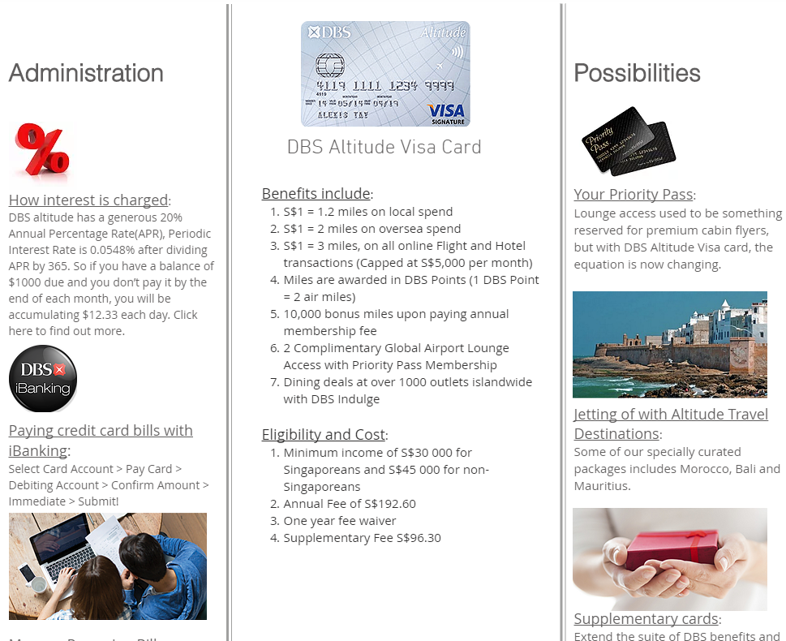
Card Information
Query Aspect:
Administration -> Benefits -> Possibilities
Information Scattered and Overwhelming

Slide 20
Demo

Slide 21
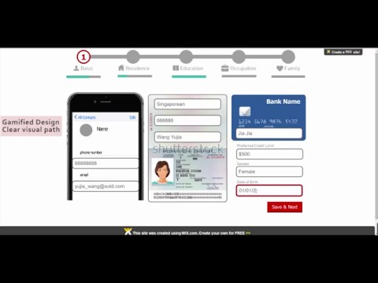

Slide 22
Evaluation

Slide 23


User Testing
User Feedback

Slide 24
User Testing
User Feedback

Slide 25



User Testing
Design
Materials
12 SUTD Students
Screen Recording
Duration
Number of Card Details Viewed
Users
Procedure
User Scenarios

Slide 26
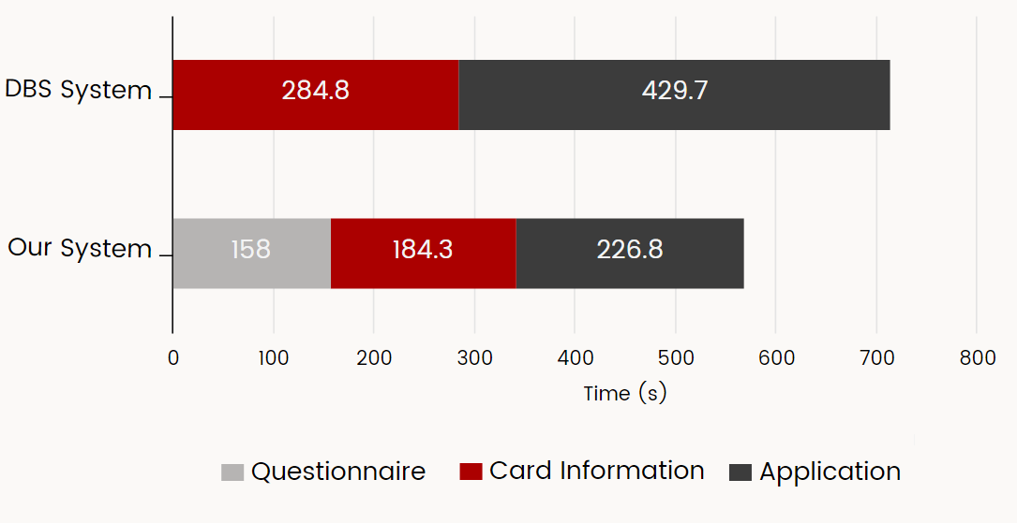
User Testing Results: Duration

Slide 27
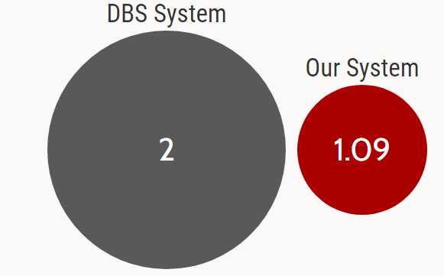
User Testing Results: # of Card Details Viewed
DBS System
Our System

Slide 28
User Testing
User Feedback

Slide 29

User Feedback
Design
Materials
12 SUTD Students
Record Feedback
Verbal Feedback in User Testing
Post-Testing Survey
Users
Procedure
Survey

Slide 30

User Feedback Results: Ease of Application Process
1
8
DBS System
Our System

Slide 31

User Feedback Results: Overall Satisfaction
0
9
DBS System
Our System

Slide 32

User Feedback Results: Ease of Learning
3
11
DBS System
Our System

Slide 33
User Feedback Results: Aesthetics
User Feedback | Our Comment
Information looks like advertisment | Follow-up on implication of the advertisement-like look
More colorful | Find out what is the preferred color scheme (we use existing DBS bank website’s color scheme for consistency)
Contact specialist (real person) | Not essential, but beneficial to include in future designs

Slide 34
Impact & Future Applications

Slide 35




Impact
Decreased boredom / sluggish feelings of application through gamification
Accelerated the selection and application process by filtering out unnecessary/irrelevant details
High Learnability
Easy reversal of actions + Relatively low error rates
Empower laymen users to make more informed choices to choose more suitable product or service.

Slide 36






Application to other domains
Web Services:
Visa Applications, Government Services
Travel Planner, Music Album, Reading List, Movie List
Daily Entertainment: TV- Auto-play TV channel
Personalized services: Diet Planner , Suitable Dress Code
E- commerce apps- retail, food, etc
Customer Service / Hotline
Education- encouraging kids to complete homework using gamification
Notes:
Web Services:
Visa Applications, Government Services
Travel Planner
Music Album, Reading List, Movie List
Daily Entertainment: TV- Auto-play TV channel based on user preferences
Personalized services: Diet Planner , Suitable Dress Code
E- commerce apps- retail, food, etc
Customer Service / Hotline
Education- encouraging kids to complete homework by employing gamification

Slide 37


Visa Application
Complete your profile
Status:
Immigrant
Student
Government
Purpose:
Travelling
Family visit
Study
Visiting Scholar
Length of Stay:
Less than 30 days
31 days to 6 month
More than 6 month
Region:
Asian
Mexian
African
Others
Recommended for You:
Visa Type | Processing time | Validity Period | Application fee | Apply Now
F-1 | 3 months | 2 years | $100
J-1 | 3 months | depends | $50
H1B | 6 months | long-term | $200
Tourist Visa | 15 days | depends | $50

Slide 38

Smart TV Channels
Genre:
Variety Shows
Dramas
Documentaries
Movies
TV Timeslots:
5pm- 6pm
6pm- 7pm
7pm- 8pm
8pm-9pm
9pm - 10pm
10pm- 11pm
11pm-12 am
Favourite Channels:
KBS
TVB
Discovery Channel
Questionnaire automatically appears when TV is newly installed, user can change options again in future.
Recommendation
9 pm: TV auto-switches to channel that is showing what the user likes
Customize your Preferences:
Genre:
Variety Shows
Dramas
Documentaries
Movies
TV Timeslots:
5pm- 6pm
KBS- “Return of Superman”

Slide 39
Thank you!
Q&A

Slide 40
Restaurant Booking Application
Complete your profile
Budget:
Low ($0- 10)
Middle($20- 50)
High($50 and above)
Allergy/Dislikes:
Cheese
Spicy Food
Prawn
Dietary Restrictions:
Halal
Vegetarian
Cuisine:
Chinese
Indian
Malay
Japanese
Western
Mexican
Others:
Recommended for You:
Restaurant | Budget | Allergies | Dietary Restrictions | Cuisine | BOOK NOW
Very Celery
Yoga Hotpot
Bear Bear
All about Eggs |  | D

